Slide 1
Introduction to B18 Biodiversity and Ecosystems
We are focusing on this topic because...
Although this is normally taught in year 11 we have chosen this topic for independent learning. This is because it is a topic that you have some prior knowledge of from KS3 already.
It will help you because…
It will ensure a whole Biology chapter has been completed so we will not be too behind schedule. It will give you a deeper understanding of how humans impact our word.
Note: All of the lessons in this chapter can also be found on the following firefly page.
https://bishopstopford.fireflycloud.net/science-2/school-closure-tasks/year-10-1/biology/triple/b18-biodiveristy-and-ecosystems

Slide 2
Introduction to B18: General Information
Print off the specification sheet and stick it in your book. If you don't have access to a printer don't worry, just leave a page and you can print it when we are back in school.
For each lesson in the chapter start by copying the Title, Date and LOs into your book.
You can either print out the sheets if you have access to a printer, or just write your answers in your exercise book – which ever is easiest for you!
The specification sheet can be found on the firefly page:
https://bishopstopford.fireflycloud.net/science-2/school-closure-tasks/year-10-1/biology/triple/b18-biodiveristy-and-ecosystems

Slide 3

B18 Lesson 1
Bishop Stopford School
faith | justice | responsibility | truth | compassion
Learning Objectives
Retrieval
Acquire
Action
Review
Dig Deeper
ONLINE LEARNING

Slide 4
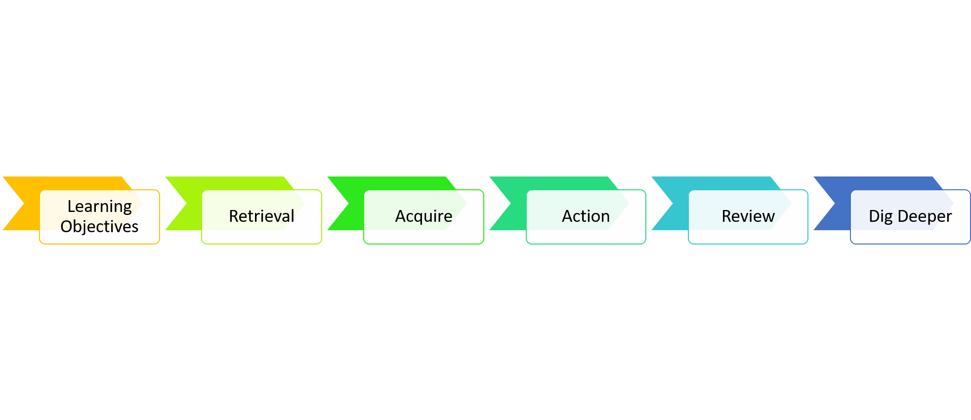
Waste and Pollution
1.Give examples of human activities that cause pollution
2.Explain issues associated with pollution

Slide 5
Starter
KS3 knowledge questions (if you can't remember from your head look them up!):
1) What are the three fossil fuels
2)Name two polluting gasses that are released when fossil fuels are burnt

Slide 6


Watch the video
You can watch this video as many times as you want to

Slide 7
Key Notes
As the human population increases, the volume of waste and pollution that is produced also increases. Polluting an ecosystem harms or kills the organisms that live within it. Human activity pollutes our land, air and our water!

Slide 8
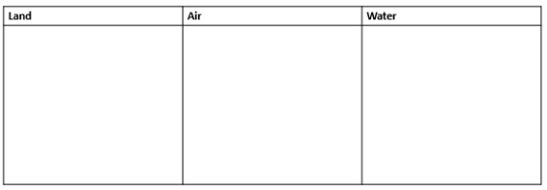
Task
Create a table to summarise all the different ways that humans pollute the Land, Air, and Water
Remember that you are not expected to do the tasks in these lessons completely from your head. Use your revision guide, the online kerboodle textbook and the internet to complete the following, to support your learning.

Slide 9

Review
RAG (red, amber, green) the learning objectives you wrote down at the start to show how confident you are with them

Slide 10
Dig deeper (optional)
Research how science is being/could be used to reduce pollution. Write a paragraph summarising what you found out

Slide 11
Extension video

